Slide 1

ConcertSaver
Your Ticket to Discounted concert
Charlotte Isabel Busse Mejia
Chien Chuan Huang

Slide 2
DESCRIPTION
ConcertSaver is a mobile application designed to provide users with discounted concert tickets.
The app aims to simplify the process of finding and purchasing concert tickets at a discounted rate.
By offering discounted tickets, ConcertSaver aims to make attending concerts more affordable and accessible for users.
Target Users: Concert enthusiasts, bargain hunters, individuals looking for affordable entertainment options.

Slide 3
OPERATIONS
Use-cases | User stories | Functionality
User Registration | As a new user, I want to register for an account so that I can access discounted event tickets. | User registration form with fields for username, email, password.
User Login | As a registered user, I want to log in to my account so that I can browse and purchase discounted event tickets. | Login screen with fields for username and password. Option for social media login.
Concert Search | As a concert enthusiasts, I want to search for concerts by keywords or categories so that I can find events that interest me. | Search bar for keyword search. Categories for browsing concerts: City, Venue, Artists. Filter options to narrow down search results.
View Concert Details | As a potential ticket buyer, I want to view detailed information about a specific concert so that I can decide if I want to purchase tickets. | Display concert details: Event name, date, time, venue, description, artists. Show original ticket price and discounted price. Option to add tickets to cart.
Purchase Tickets | As a ticket buyer, I want to purchase discounted concert tickets so that I can attend the concert. | Option to add tickets to cart and proceed to checkout. Choose a payment method. Payment confirmation and receive the ticket’s QR code upon successful purchase.

Slide 4


User Interface Mockups

Slide 5
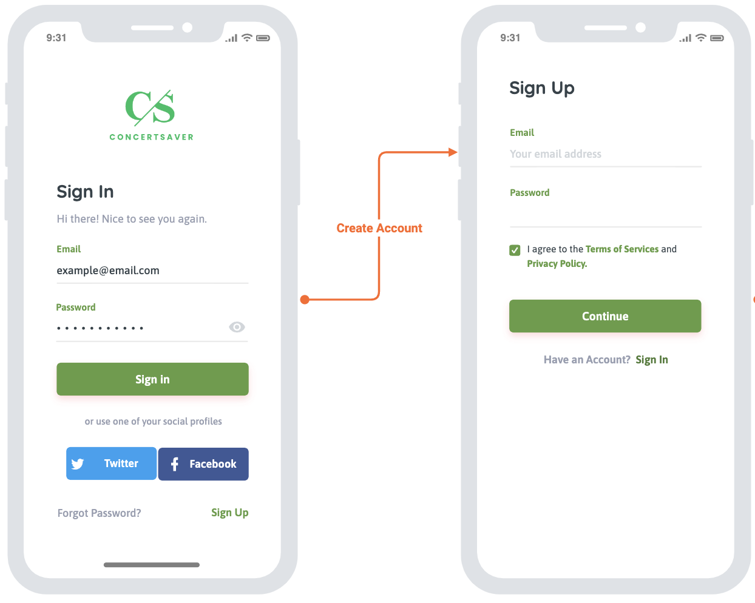
Login Screen
Includes fields for username and password.
Option for social media login (e.g., Facebook, Twitter).

Slide 6
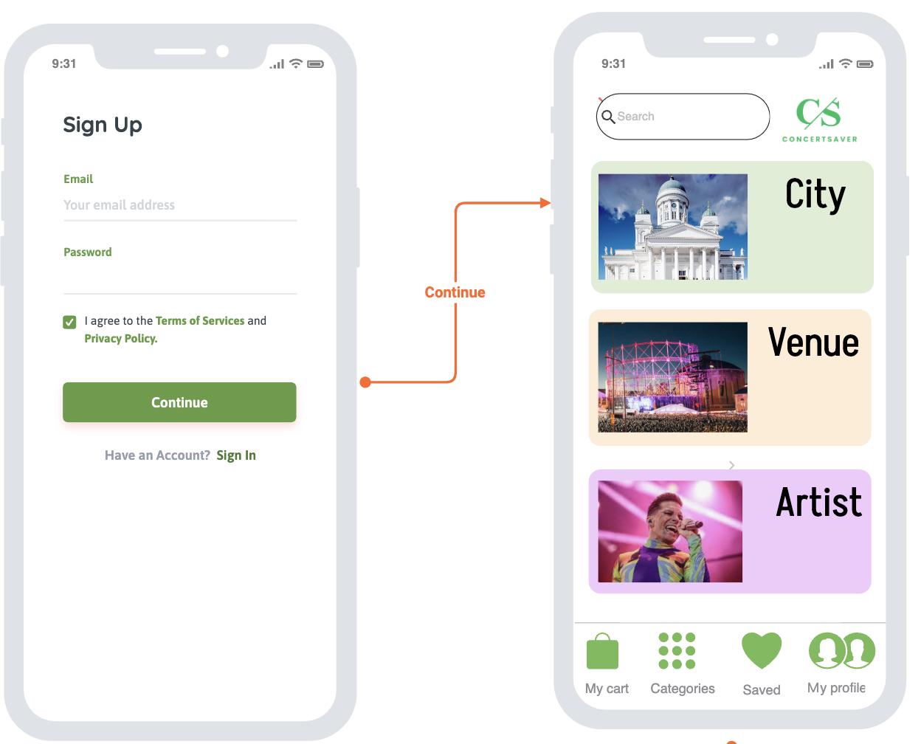
Concert Search and Browse Screen
Includes search bar for keyword search.
Categories for browsing events: City, Venue, Artist.
Below is the Tap bar section, with "My cart", "Categories", "Saved", and "My profile”.

Slide 7
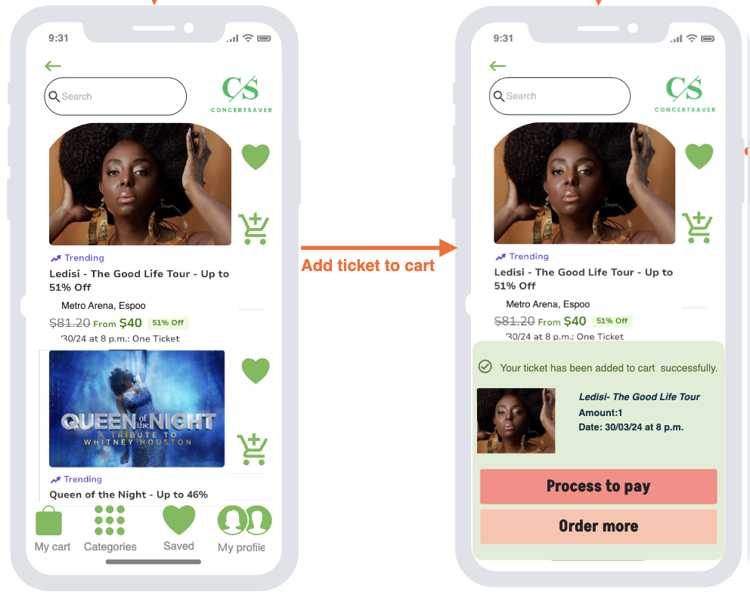
Discounted Concert Ticket Details
Displays concert details: Concert name, date, time, city, venue.
Shows original ticket price and discounted price.
Option to add tickets to cart and proceed to checkout.

Slide 8
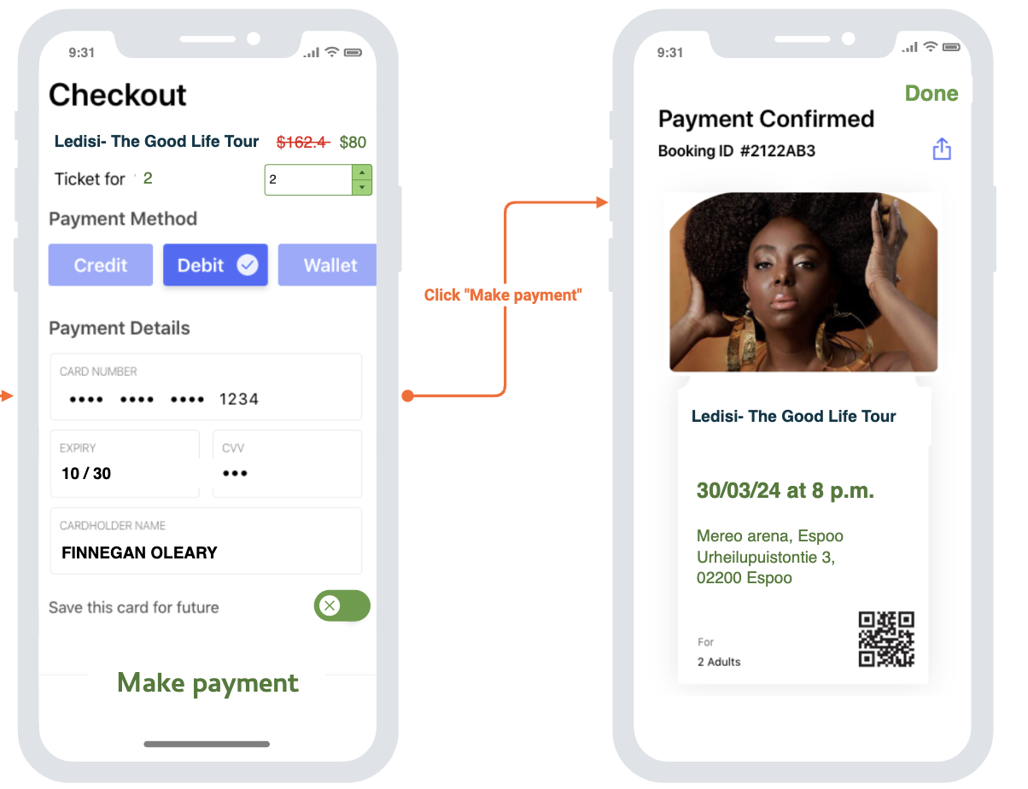
Checkout
Choose a payment method.
Upon confirmation of payment, receive the ticket's QR code.

Slide 9
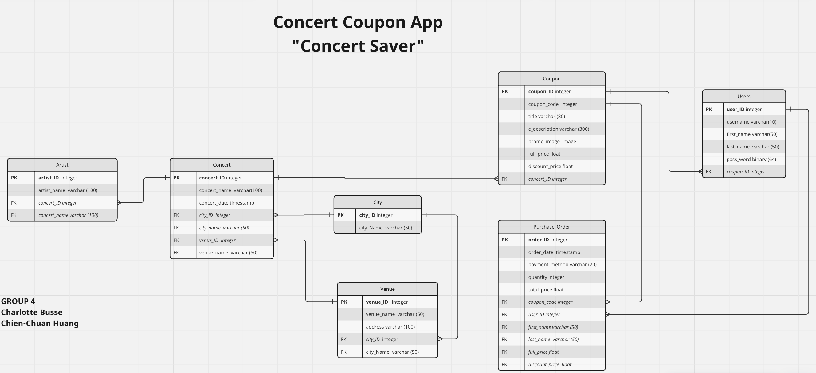
Schema

Slide 10
THANKS!

